Slide 1
Lecture One: An overview of Database Management
What you will learn from this lecture:
Introduction
What is a Database System
What is Database
Database Systems and File Systems
Data Models
Data Definition Language
Data Manipulation Language
SQL

Slide 2
1. Introduction
人工管理（20世纪50年代中期以前）
数据不进行电子保存
数据由应用程序管理，不具有共享性
数据查询、插入、修改、更新等操作困难
举例：人工填写的表格、传统档案等
文件系统阶段（20世纪50年代后期-60年代中期）
数据保存在数据文件中，可以进行查询、插入、更新等操作
数据由文件系统进行管理，但程序与数据的独立性仍较差
数据文件面向应用，相互之间缺乏联系，共享性差
数据库系统阶段（20世纪60年代末至今）

Slide 3
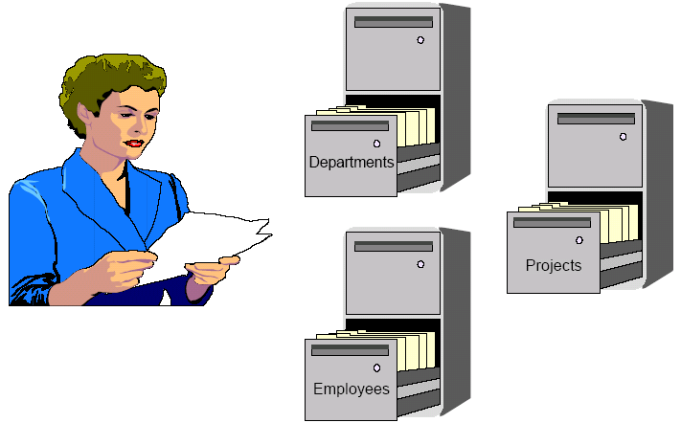
1. Introduction
Computerless Data Storage

Slide 4
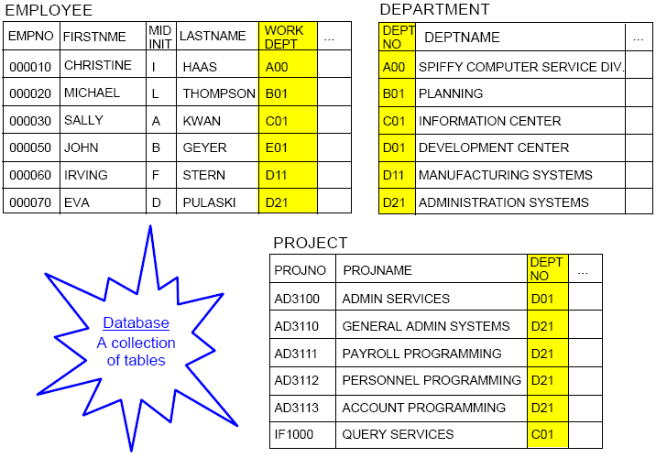
Relational Database Management System 关系数据库管理系统

Slide 5
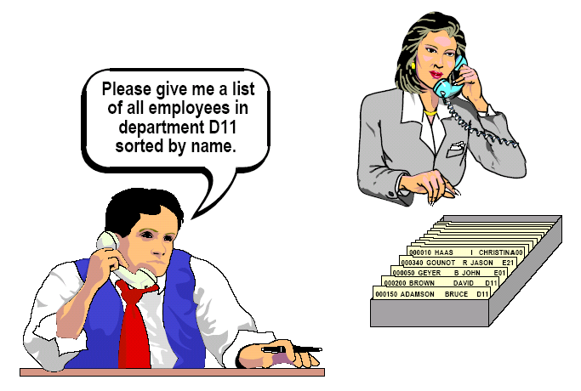
Computerless Data Retrieval

Slide 6
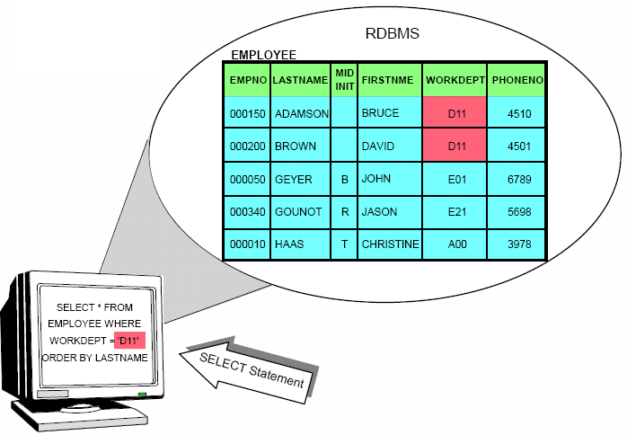
Asking for Information-RDBMS
I need
a listing of employees
in department D11
sorted by last name.
SELECT *
FROM EMPLOYEE
WHERE WORKDEPT=‘D11’
ORDER BY LASTNAME;

Slide 7
1. Introduction
数据库系统阶段（20世纪60年代末至今）
数据存放在数据库中，并用数据模型来描述数据本身以及数据之间的联系
数据是面向系统的，冗余度低，可以共享
对的数据的查询、插入、修改、更新等操作方便
数据具有安全性、一致性、持久性、共享性等特性，以及操作的并行性

Slide 8
2. What is a Database System
Definition
Operations on the data (file)
E.g.
Retrieving data from existing files
Inserting data into existing files
Four major components of a Database System

Slide 9
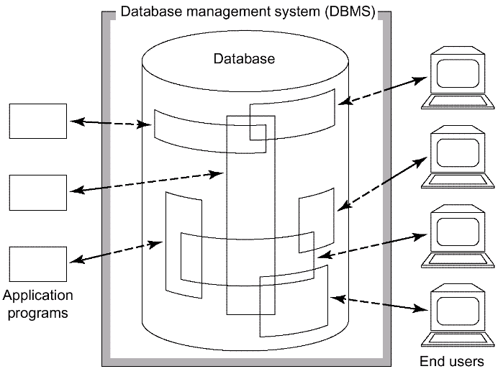
2.1 Definition
Computerized record-keeping system
Store information
Allow users to retrieve and update information on demand
权限
共享
Fig. 1.4 Simplified picture of a database system

Slide 10
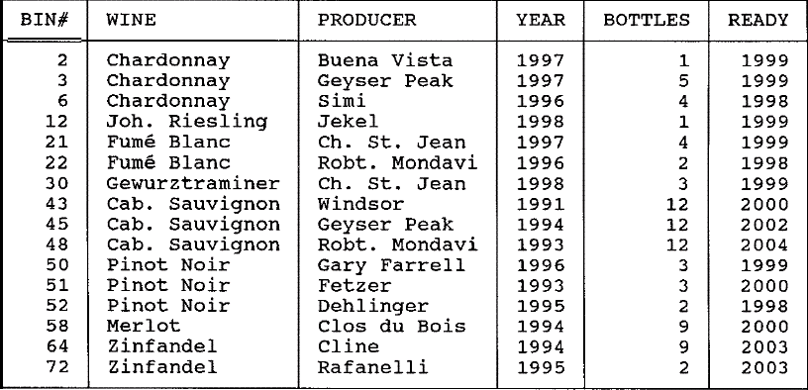
Collection of interrelated data
Fig. 1.1 The wine cellar database (file CELLAR)

Slide 11
2.2 Operations on the data (file)
Adding new, empty files to the database;
Inserting data into existing files;
Retrieving(取出) data from existing files;
Changing data in existing files;
Deleting data from existing files;
Removing existing files from the database.

Slide 12
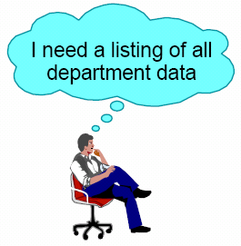

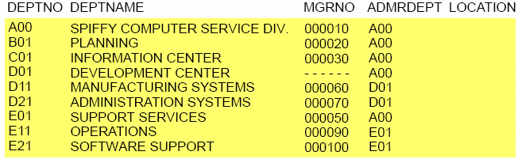
E.g. Retrieving data from existing files
;

Slide 13
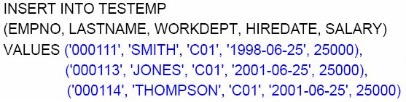

E.g. Inserting data into existing files

Slide 14
2.3 Four major components of a Database System
Data
Hardware
Software
Users

Slide 15
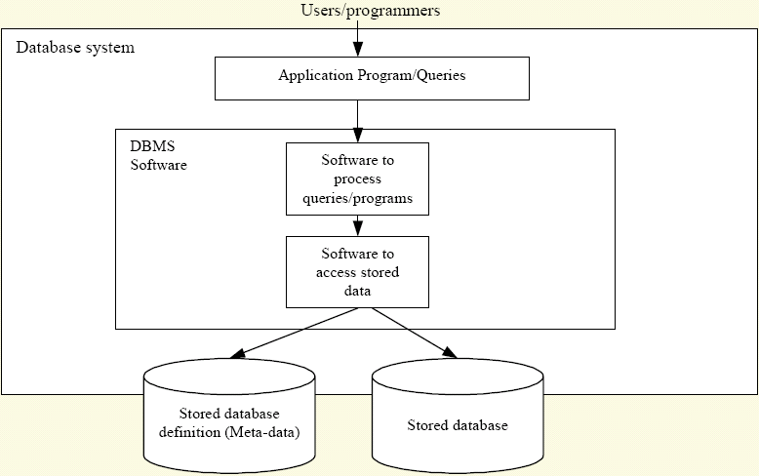
四部分之间的关系
USERS
SOFTWARE (DBMS)
Supported by hardware
DATA

Slide 16
Data
Data: Data refer to what is actually stored in the database.
Information: refer to the meaning of that data as understood by some user.
The terms “data” and “information” are treated as synonymous(同义的) in this book.
Data is integrated.
Data is shared.

Slide 17
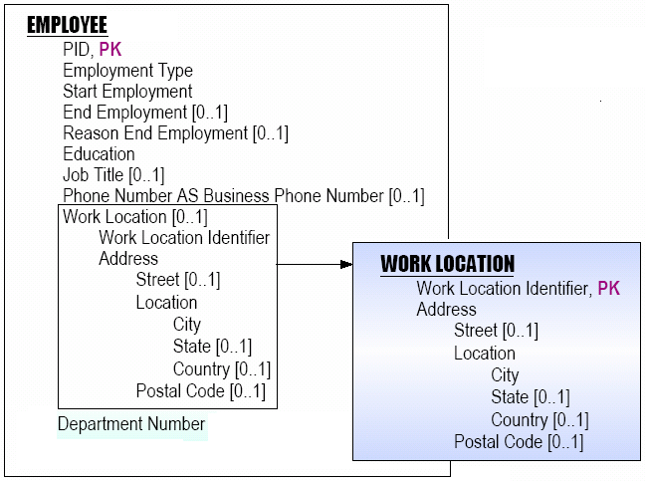
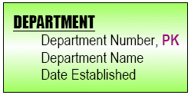
Data is integrated and shared.
ENROLLMENT
PID ,PK
COURSE ,PK
…
Training Department
Personnel Department

Slide 18
Hardware and Software
Hardware
Magnetic Disks, disk drives: store information
Hardware Processor(s) and Associated Main Memory: running DBS software
Software: Database Management System
(DMBS，数据库管理系统)
E.g.,
Oracle, DB2, SQL Server, Access, MySQL, …

Slide 19
User
Application Programmers
End User
Data Administrator (DA,数据管理员):
Decide what data should be stored in the database in the first place.
Establish policies for maintaining and dealing with that data once it has been stored.
E.G., data security policy
Database Administrator (DBA,数据库管理员):
IT technical person responsible for implementing the data administrator's decisions.
Create the actual database and implement the technical controls needed to enforce the various policy decisions made by the data administrator.

Slide 20
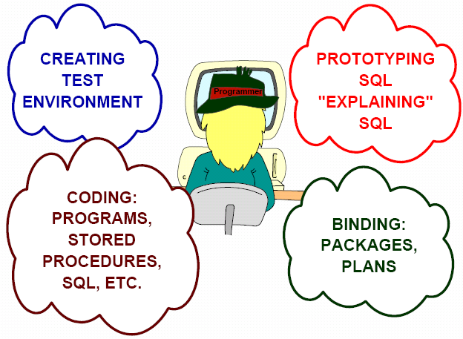
Application Programmers
……

Slide 21
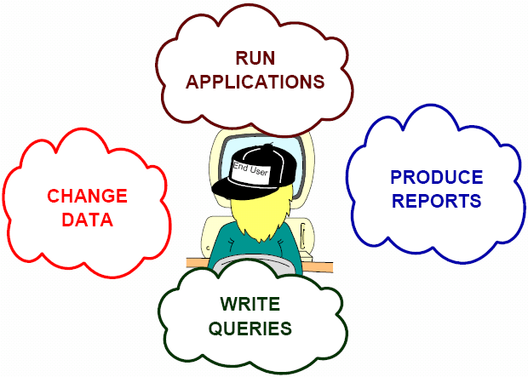
End User

Slide 22
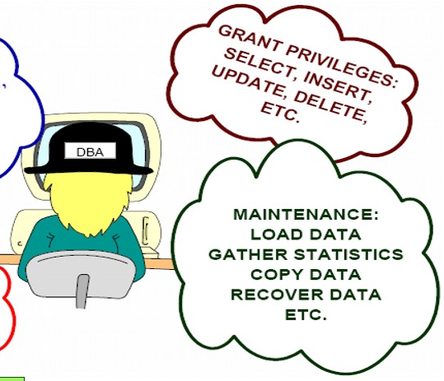
Database Administrator
CODING AND CREATING OBJECTS, TABLES, INDEXES, VIEWS, ETC.
…

Slide 23
3. What is a Database?
Database: A collection of persistent data that is used by the application systems of some given enterprise.
Persistent data: Be removed from the database only by some explicit request to the DBMS.
Data examples
Product data
Customer data
Student data
Account data

Slide 24
Enterprise examples:
A manufacturing company : production, inventory, orders, supply chain
A bank : all transactions
A university : student, course, grades
A hospital: patients, doctors, medicine, prescription
Airlines: reservations, schedules
Sales: customers, products, purchases
Human resources: emp records, salaries, tax deductions
A single individual with a small personal database
E.g., Northwind.mdb
Databases touch all aspects of our lives

Slide 25
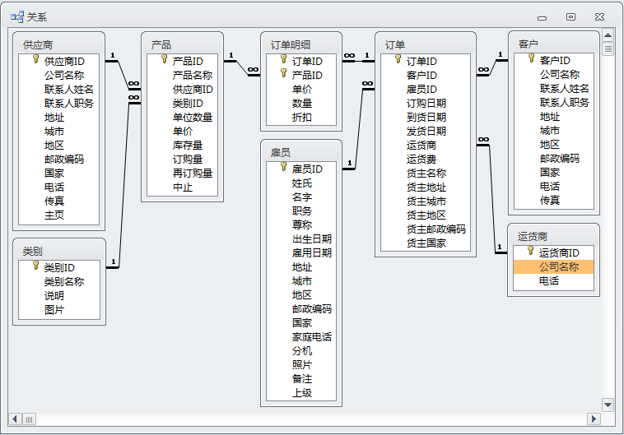

Slide 26
客户、雇员、运货商和订单表间的联系

Slide 27
订单、订单明细和产品表间的联系

Slide 28
产品、类别和供应商表间的联系

Slide 29
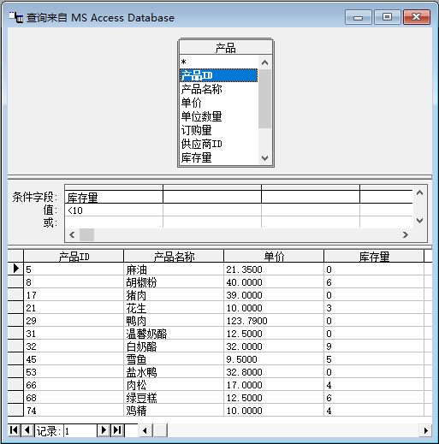
数据库的单表查询

Slide 30
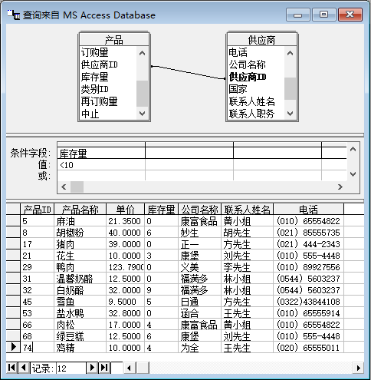
数据库的多表查询——连接查询
查询显示库存量小于10的产品的ID、名称、单价、库存量和供应商的公司名称、联系人姓名和电话等信息。

Slide 31
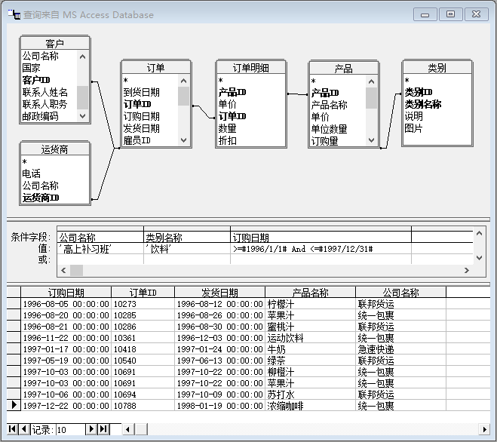
数据库的多表查询——连接查询
查询“高上补习班”这个客户在1996年至1997年购买饮料的订单信息及运货商名称。

Slide 32
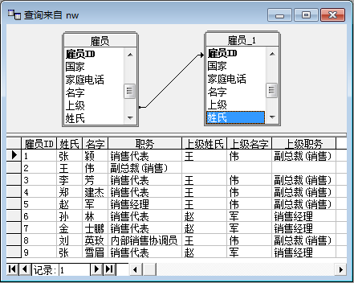
查询雇员的ID、姓氏、名字、职务以及其上司的姓氏、名字和职务，查询和了解Northwind公司人员的上下级关系。

Slide 33
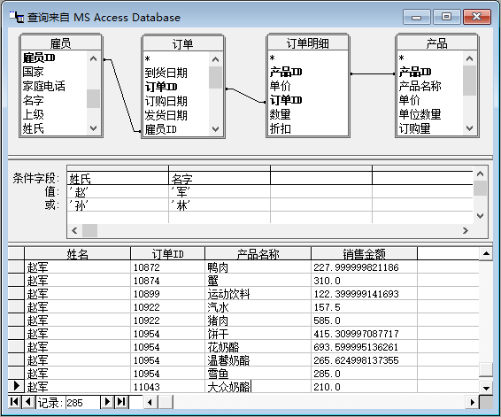
通过一定的计算，查询数据库表中没有的属性值

Slide 34
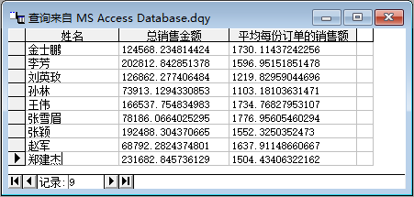
通过分类汇总，查询数据库表中没有的属性值

Slide 35
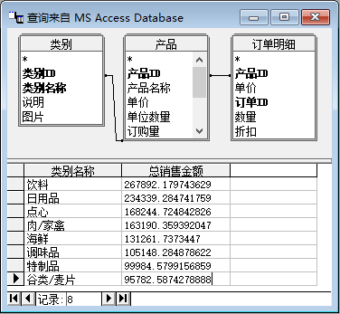
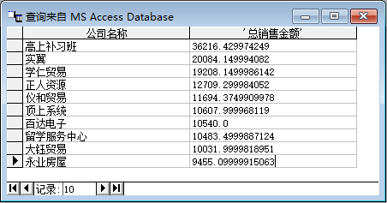
通过分类汇总，查询数据库表中没有的属性值

Slide 36
4. Database Systems and File Systems
Drawbacks of using file systems to store data
Benefits of the Database Approach
When not to use a database system?

Slide 37
4.1 Drawbacks of using file systems to store data
Data redundancy(冗余) and inconsistency(不一致)
Multiple file formats, duplication of information in different files
Difficulty in accessing data
Need to write a new program to carry out each new task
E.g. , get the balance of accounts whose balance are less than 1000.
Data isolation — multiple files and formats
Integrity(完整性) problems
Integrity constraints (e.g. account balance > 0) become part of program code
Hard to add new constraints or change existing ones

Slide 38
4.1 Drawbacks of using file systems to store data…
Atomicity(原子性) of updates
Failures may leave database in an inconsistent state with partial updates carried out
E.g. , transfer of funds from one account to another should either complete or not happen at all
Concurrent access by multiple users
Concurrent access needed for performance
Uncontrolled concurrent accesses can lead to inconsistencies
E.g. , two people reading a balance and updating it at the same time
Security problems
 DBS offer solutions to all the above problems

Slide 39
4.2 Benefits of the Database Approach
The data can be shared
Redundancy can be reduced (to some extent)
Inconsistency can be avoided Transaction support can be provided
Integrity can be maintained
Security can be enforced
……

Slide 40
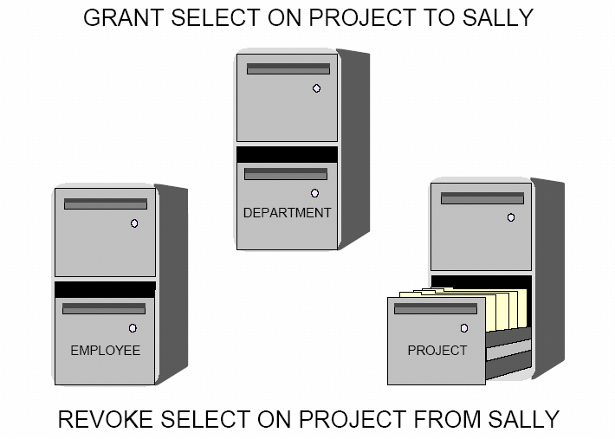
Security-Authorization

Slide 41
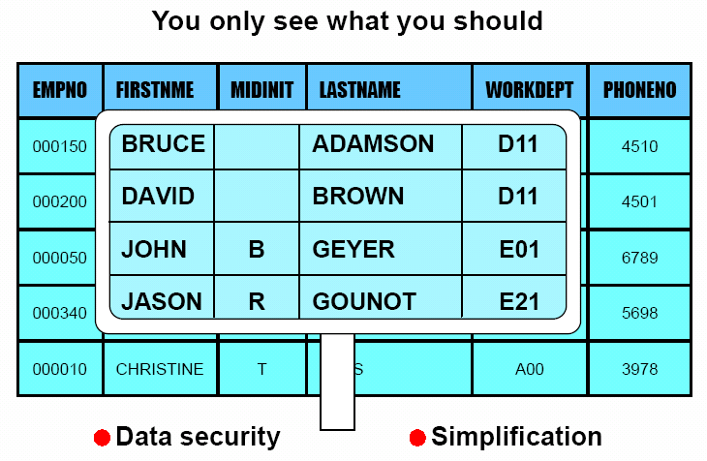
Security-view

Slide 42
4.3When not to use a database system?
DBMS requires additional overhead!
High initial investment in hardware, software and training.
Overhead for providing security(安全性), concurrency control(并发控制), recovery(数据库恢复) and integrity(完整性) functions.
There are still a lot of applications that use files.
The database and application are simple, well-defined, and not expected to change -- usually dealing with small size of data.
There are stringent real-time requirements for some programs that may not be met because of DBMS overhead.
Multiple-user access to data is not required.

Slide 43
5. Data Models
A collection of tools for describing
Data, Data relationships (联系)
Data semantics (语义), Data constraints (约束)
Entity-Relationship model
Relational model
Other models:
Object-oriented model (面向对象模型)
Semi-structured data models (半结构化模型)
Older models: network model(网状模型)
hierarchical model(层次模型)

Slide 44
5. Data Models
Entity-Relationship model
实体联系模型是数据库设计中的一个重要概念数据模型，用于描述数据库的概念模式，而不考虑数据库的逻辑与物理结构。‌
ER模型通过定义实体、属性、联系等基本概念，充分反映现实世界，使得现实世界的事物以信息结构的形式方便地表示出来。
该模型在将现实企业的需求和业务交互映射到概念模式上非常有用，是桥梁。

Slide 45
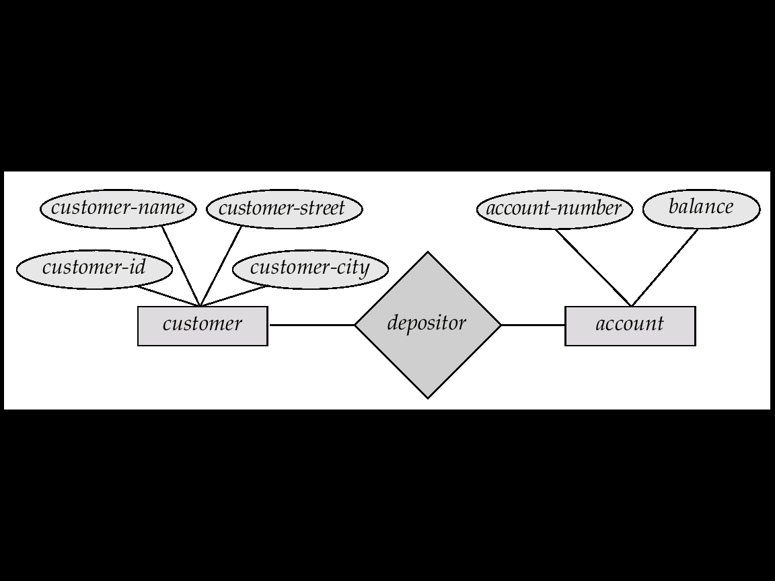
5.1 Entity-Relationship Model
Example of schema in the entity-relationship model
Entity
Relationship
Entity

Slide 46
E-R
Model
Be converted to
Relational
Model

Slide 47
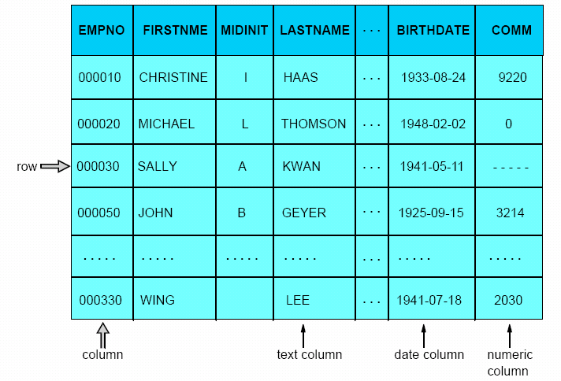
5.2 Relational Model
Example of tabular data in the relational model
EMPLOYEE

Slide 48
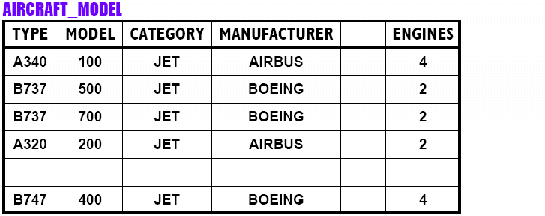
Components of Tables

Slide 49
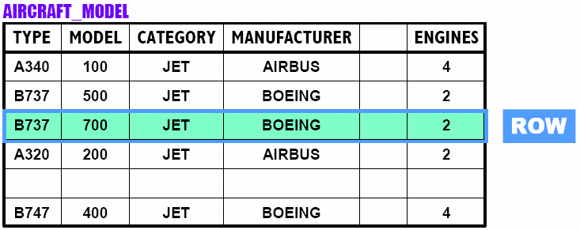
Components of Tables(Cont.)

Slide 50
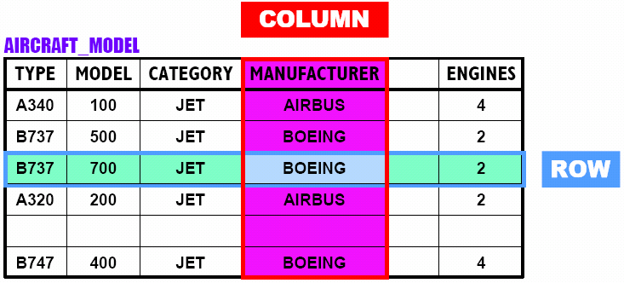
Components of Tables(Cont.)

Slide 51
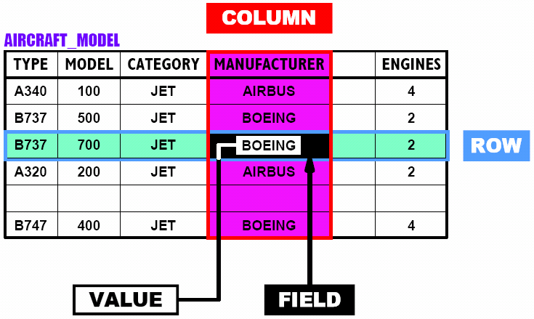
Components of Tables(Cont.)

Slide 52
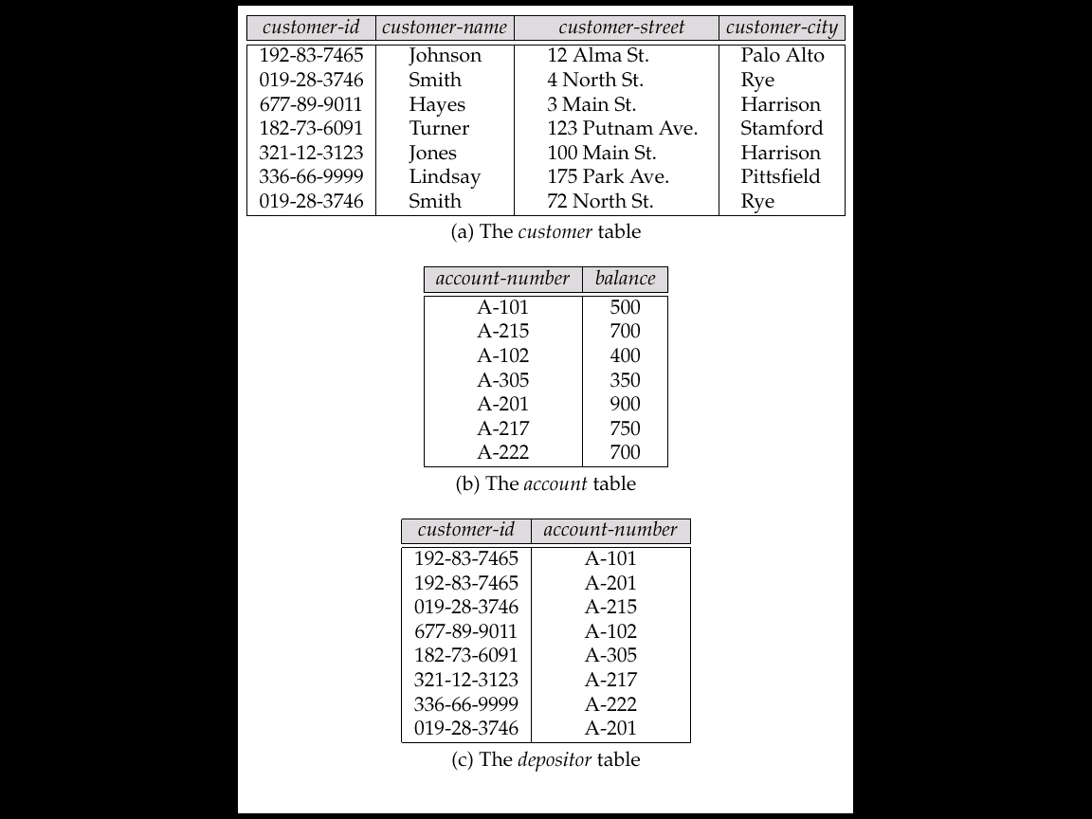
A Sample Relational Database
联系

Slide 53
6. Data Definition Language (DDL)
DDL: Specification notation for defining the database schema.
E.g. Create table account ( account-number char(10) Primary Key, balance integer);
DDL compiler
generate
Stored in
Data Dictionary
DDL
Tables

Slide 54
Data dictionary contains metadata (i.e., data about data)

Slide 55
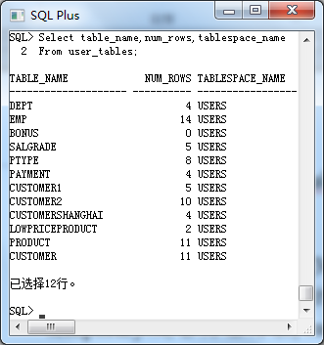
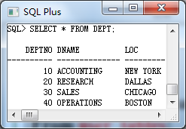
Data dictionary of Oracle11g
Select table_name,
num_rows,
tablespace_name,
From user_tables ;
table_name表名
num_rows 表中行数
tablespace_name
存储表名的表空间
系统表
用户表

Slide 56
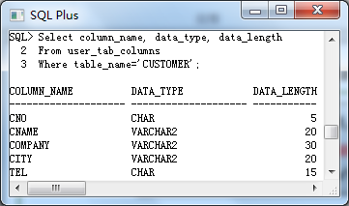
Data dictionary of Oracle11g
Select column_name, data_type, data_length
From user_tab_columns
Where table_name='CUSTOMER';
系统表

Slide 57
7. Data Manipulation Language (DML)
Language for accessing and manipulating the data organized by the appropriate data model
DML also known as query language
Two classes of languages
Procedural – user specifies what data is required and how to get those data
Nonprocedural – user specifies what data is required without specifying how to get those data
SQL is the most widely used query language

Slide 58
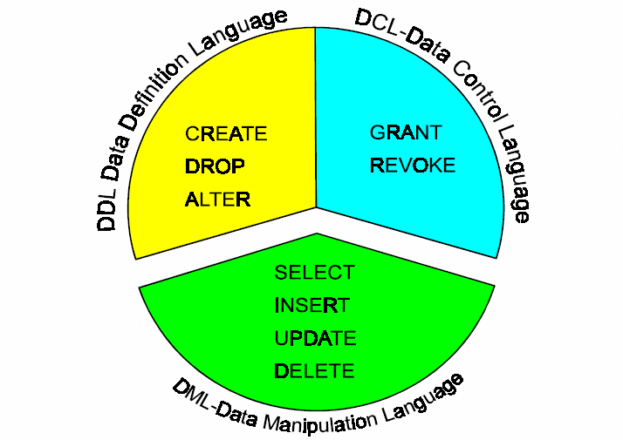
8. SQL

Slide 59
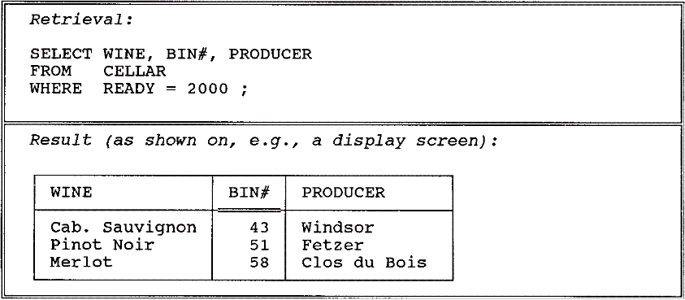
8. SQL (Cont.)
SQL: widely used non-procedural language
Fig. 1.2 Retrieval example

Slide 60
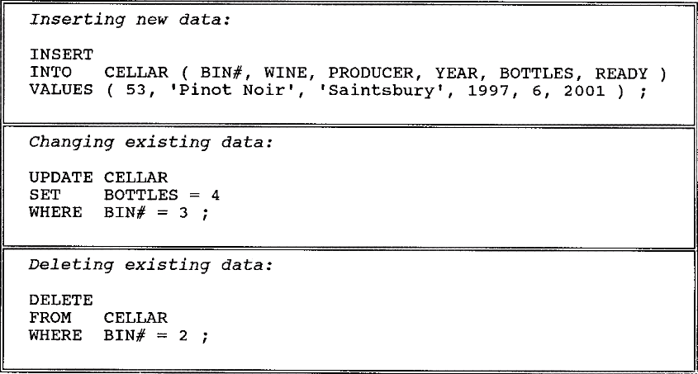
8. SQL (Cont.)
Fig. 1.3 Insert / change / delete examples

Slide 61
8. SQL (Cont.)
CREATE TABLE DEPARTMENT
( DEPTNO CHAR(3) PRIMARY KEY,
DEPTNAME CHAR(40),
MGRNO CHAR(6),
ADMRDEPT CHAR(3),
LOCATION CHAR(30),
FOREIGN KEY (MGRNO) REFERENCES EMPLOYEE,
FOREIGN KEY (ADMRDEPT) REFERENCES DEPARTMENT);
INSERT INTO DEPARTMENT VALUES(…);
…

Slide 62

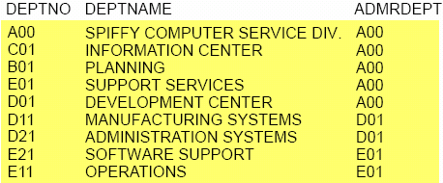
8. SQL (Cont.)

Slide 63
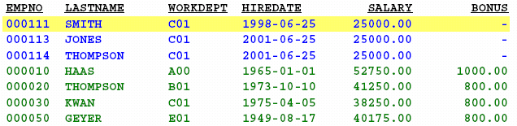
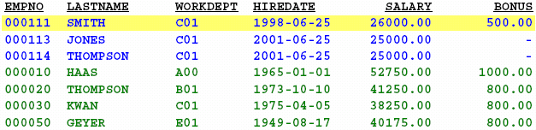
8. SQL (Cont.)
Before
Update
UPDATE TESTEMP
SET BONUS = 500,
SALARY = 26000
WHERE EMPNO = ‘000111’;
After
Update

Slide 64
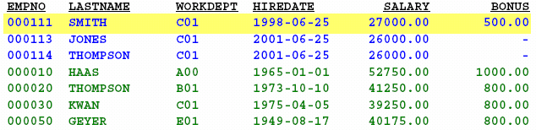
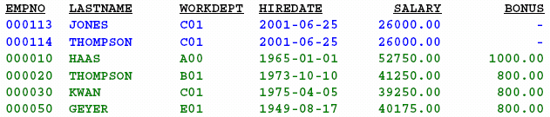
8. SQL (Cont.)
Before
Delete
DELETE FROM TESTEMP
WHERE EMPNO = ‘000111’;
After
Delete

Slide 65
8. SQL(Cont.)
Two ways of accessing databases for application programs
Language extensions to allow embedded SQL
嵌入式SQL
Application program interface (e.g. ODBC/JDBC) which allow SQL queries to be sent to a database
交互式SQL
Introduce some examples in Microsoft Access.

Slide 66

Thank You!

